Slide 1








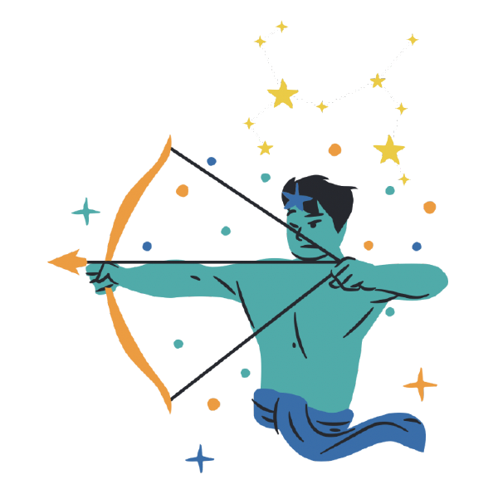



Zodiac Sign Personality Check App
Nae Hamao

Slide 2
1. App design scope
This mobile app presents personality based on the user’s zodiac sign. The reason I want to create this app is because I like horoscope! And I want to see and understand personality linked to zodiac signs. Additionally, when engaging with friends or colleagues with whom I may not always connect, referencing their zodiac sign helps me interpret our interactions.
This app additionally stores birthday information and corresponding zodiac signs which user registers, so that user can quickly check its friends zodiac signs to understand and know others personality.

Slide 3
2. Additional function
I added API which return daily horoscope. https://api.prokerala.com/ when user open to see the horoscope, at the bottom of the page, it shows daily prediction about its horoscope.
However, I faced issue with Cross-Origin Resource Sharing (CORS) which is a fundamental security mechanism implemented by web browsers to prevent unauthorized access to resources on a web page from different origins. I was able to get return value with GET request by hard code “access token” , but I still facing issue to get the token with POST request.

Slide 4



4. platform, language, IDE
Modify from Node4 project
Created JSON database by ChatGPT
I choose this because when I see work on Node4, and I could imagine what app I want to build with this framework. I also see the flexibility for the styling by using this platform, since some of the part I enjoy creating application is styling. I would like to try to use, Starbuzz project as start point because that is also use SQL to store data and return stored value. I think that is very similar concept of this application. Due to hardware restriction, I choose JSON-server to reduce heavy process to my laptop.

Slide 5
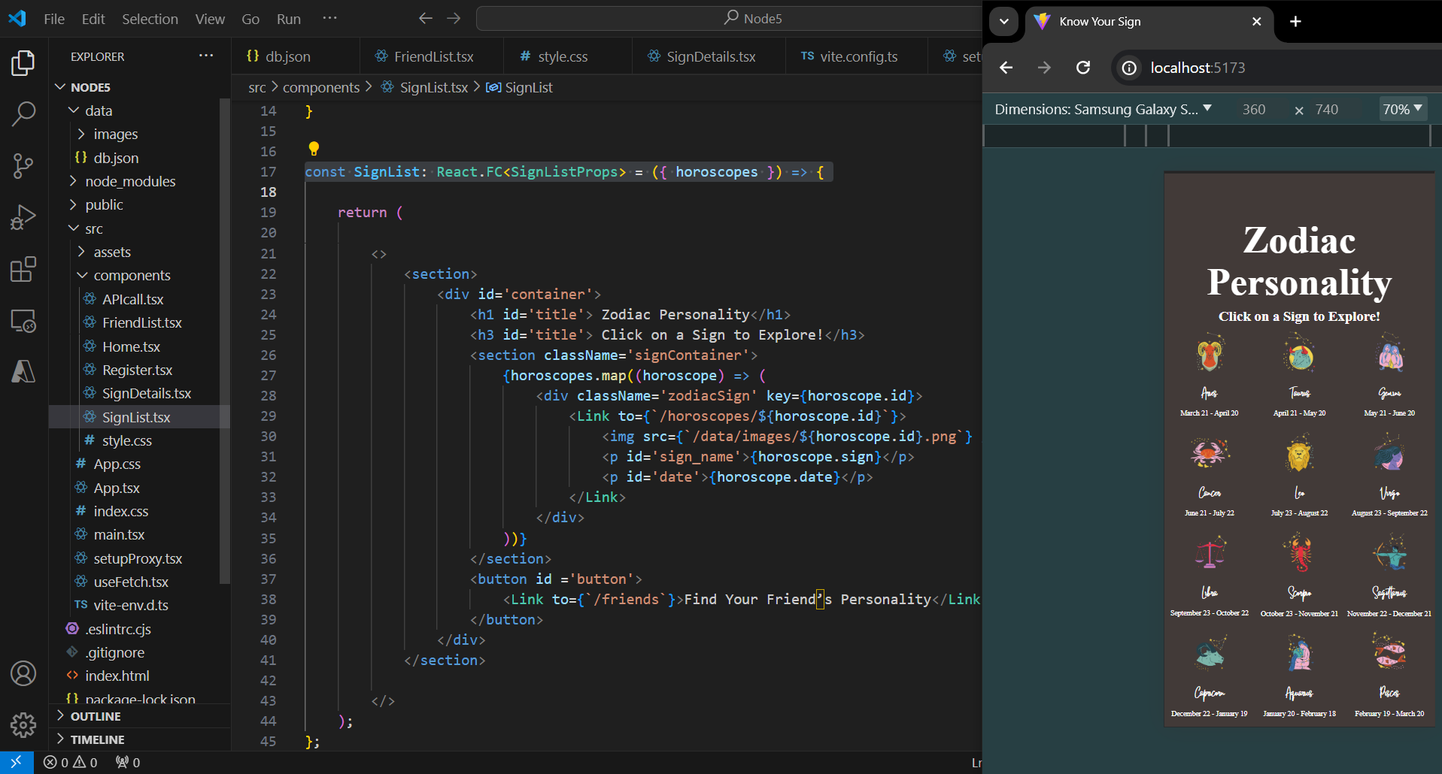
5. Code snip
Home

Slide 6
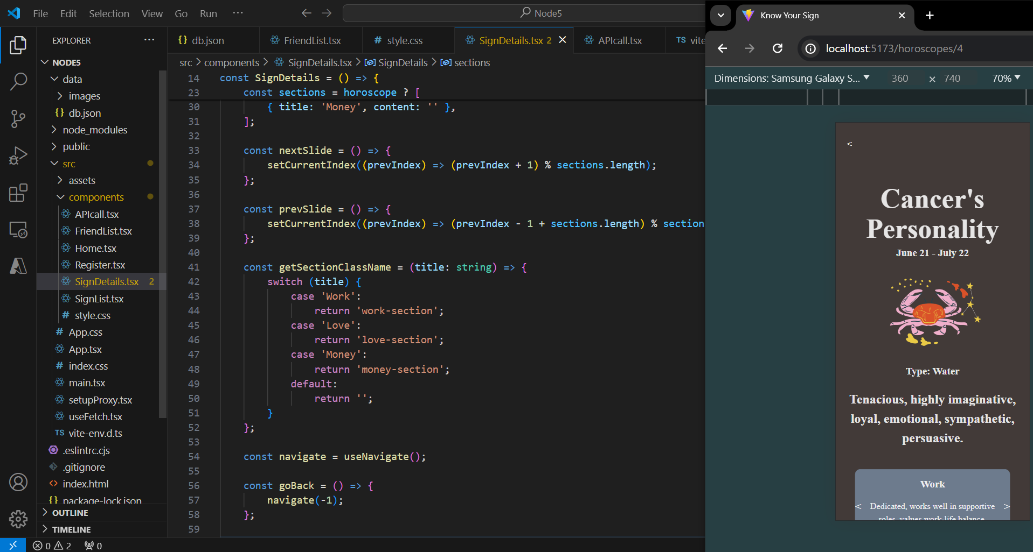
5. Code snip
Zodiac sign detail

Slide 7
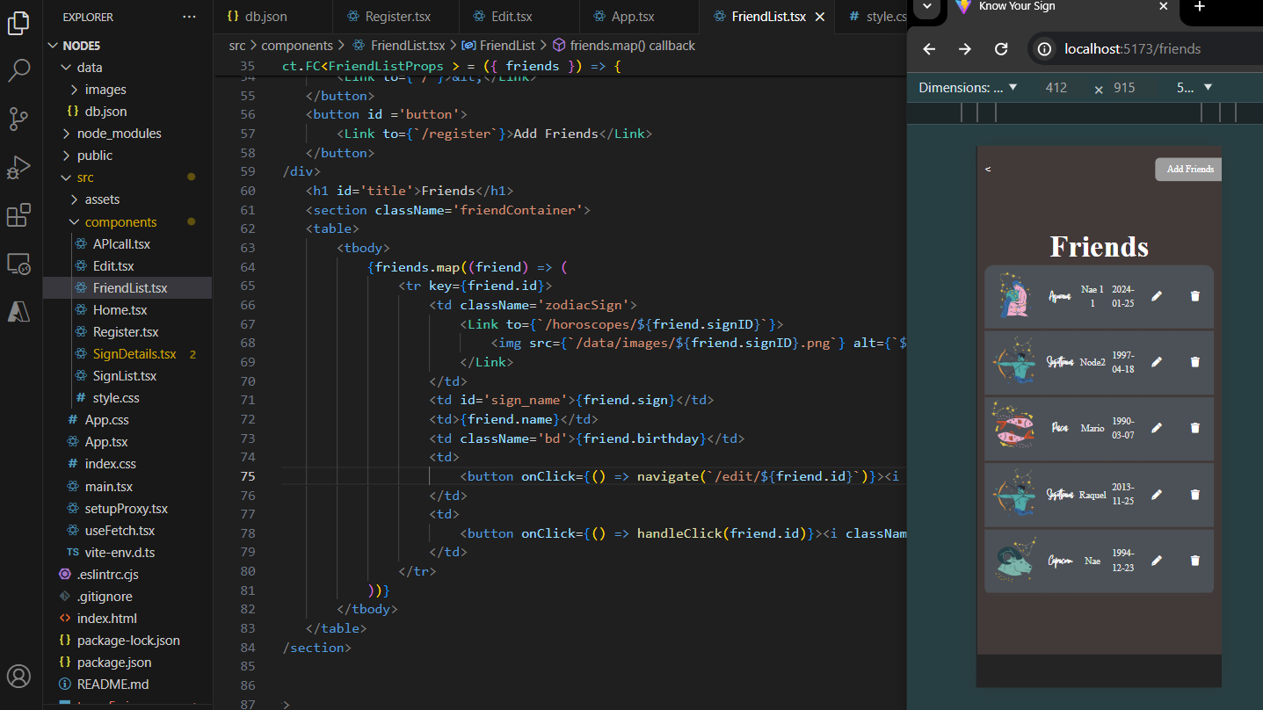
5. Code snip
List of friend

Slide 8
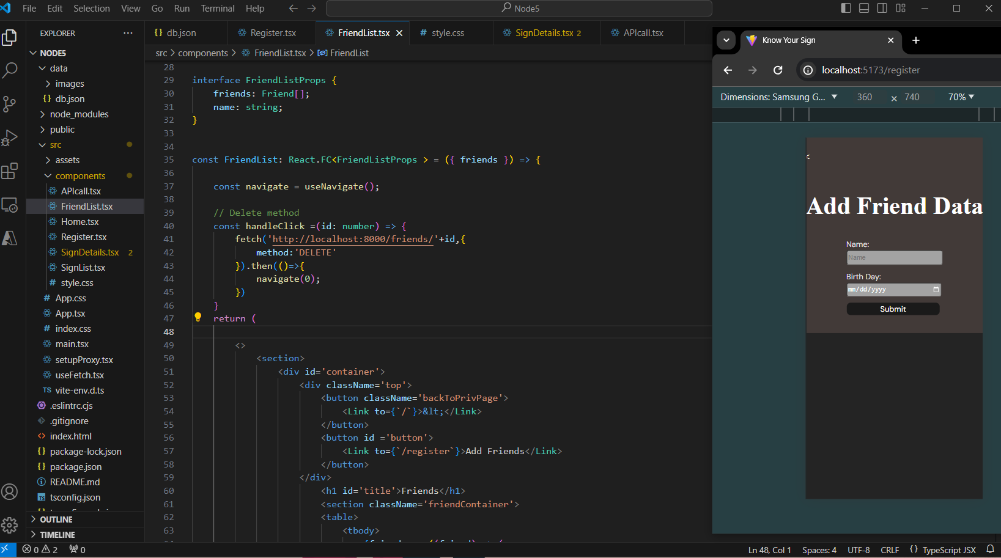
5. Code snip
Check and Add friends data

Slide 9
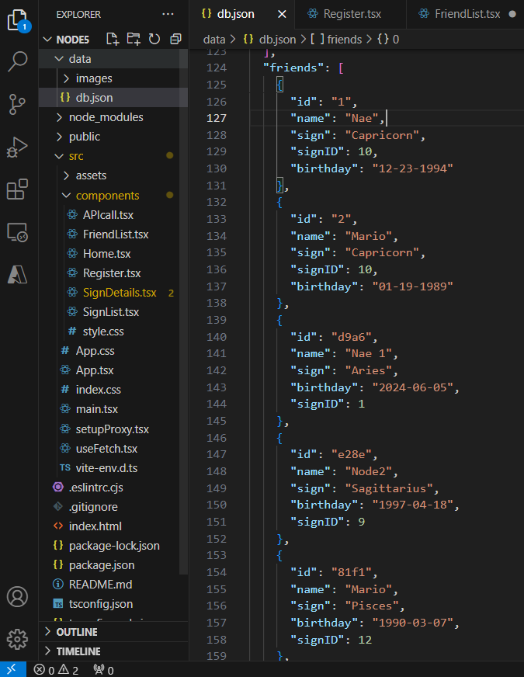
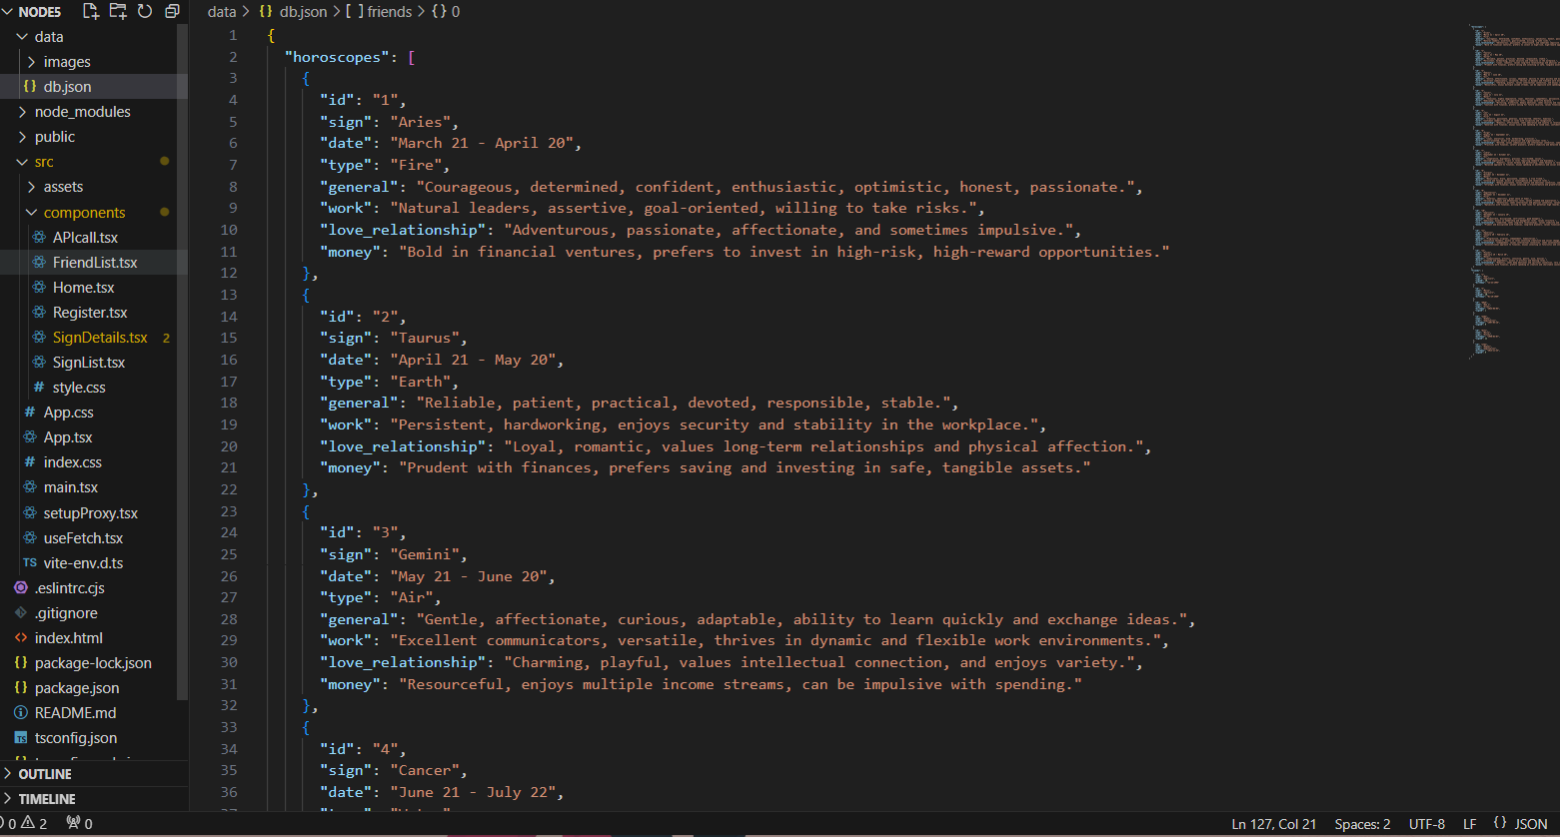
5. Code snip
JSON Data

Slide 10
experiences during the development process
How did it go? : I am 90 % of satisfaction of this application! I could create what I planed. Only one left task is fetching API. Due to API access limitation ( after some times of getting data, I also reached limit and needed to pay to API provider. so, I couldn’t keep trying)
What did you learn? : I learned the logic of this JSON-sever application. In the class, I was just following the professor, but once I start modifying, I learn how this code works. The other new knowledge is about API. I couldn’t make it through CORS limitation, but I haven’t seen that error before, so it was great opportunity to see the new errors.
What were the biggest challenges? : Very beginning was the most challenging! Even I just change variable name and file name, the application crush or doesn’t start. It happened before I fully understand code structure. However, once I found how this framework works, and watch YouTube video to support understanding, I could finally start modifying code. Since I still figuring out to access API with dealing CORS, using API is also challenging.

Slide 11
experiences during the development process
How did you overcome the challenges? : Read code line by line really carefully to see how all code are connected each other. In addition, I searched the error messages to find similar errors from other people (stackoverflow).
What is useful for the next time? : Watching YouTube to following it can be helpful at the start point. Or if I modify existing project like this time, re-create the project again can be helpful to make me better understanding.
What did you add from yourself in addition to the core assignment requirement? : API
What advice would you give to someone who is going to do something similar? : Understand how the code works, and know what is the Json-server is.

